Slide 1
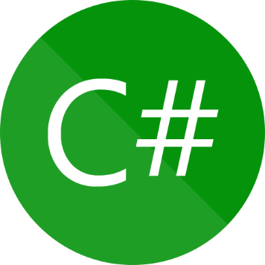

ASYNC & AWAIT SYNCHRONOUS & ASYNCHRONOUS
Presenter: mohammad adil

Slide 2



Humble request
Adil Vlogs
Techno Verse YT
Heavenly Delicious

Slide 3

What Is Synchronous In C#
START
Synchronous programming is a programming model
where operations take place sequentially
FUNCTION 1
FUNCTION 2
RESOURCE
INTERNET
2 MINUTE
FUNCTION 3
END

Slide 4
What Is Asynchronous In c#
START
Asynchronous programming is a programming model
where operations does not dependent on each other.
FUNCTION 1
FUNCTION 2
RESOURCE
INTERNET
2 MINUTE
FUNCTION 3
END

Slide 5
SYNCHRONOUS PROGRAMMING
4 seconds
2 seconds
5 seconds
1 second
FUNCTION 1
FUNCTION 2
FUNCTION 3
FUNCTION 4
Executes In a Sequence
Dependent On Each Other

Slide 6
ASYNCHRONOUS PROGRAMMING
4 seconds
2 seconds
5 seconds
1 second
FUNCTION 1
FUNCTION 2
FUNCTION 3
FUNCTION 4
3rd
2nd
4th
1st
Not Execute In a Sequence
Not Dependent On Each Other

Slide 7
ASYNC & AWAIT IN C#
Async and Await are the two keywords that help us to program asynchronously.
An async keyword is a method that performs asynchronous tasks such as fetching data from a database, reading a file, etc, they can be marked as “async”.
Whereas await keyword making “await” to a statement means suspending the execution of the async method it is residing in until the asynchronous task completes.

Slide 8
ASYNC & AWAIT IN C#
After suspension, the control goes back to the caller method.
Once the task completes, the control comes back to the states where await is mentioned and executes the remaining statements in the enclosing method.

Slide 9
Task Class In C#
The Task class will always represent a single operation and that operation will be executed asynchronously on a thread pool thread rather than synchronously on the main thread of the application.

